Slide 1
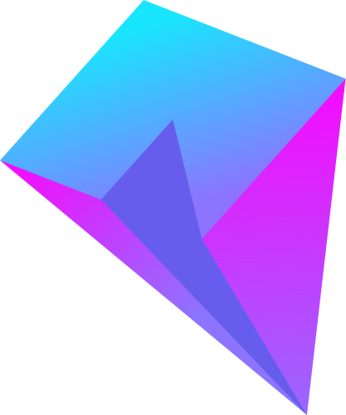
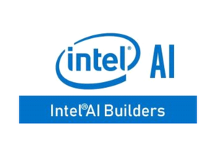
DEEP LEARNING
Use Of AI By
INTEL
PRESENTED BY:
MUSKAN GARG
2115800018

Slide 2



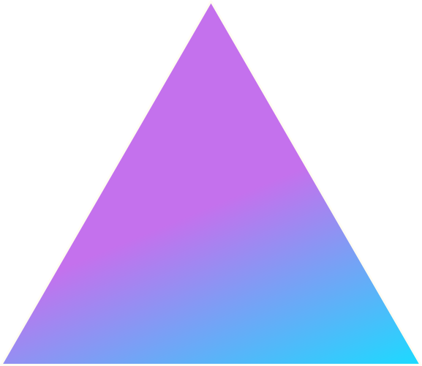
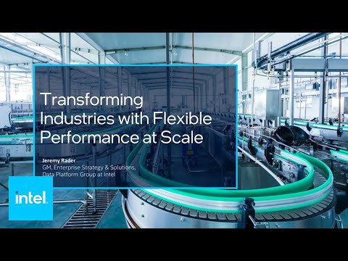

INTEL
INTRODUCTION
Intel Corporation is an American multi-national technology company and one of the world's largest semiconductor chip manufacturers.
Founded on July 18, 1968, by Robert Noyce and Gordon Moore.
Key aspects of Intel:
Semiconductor Manufacturing
Microprocessor Innovation
Data Center Solutions
Internet of Things (IoT)
Artificial Intelligence (AI)
Innovation and Research
Research and Development

Slide 3
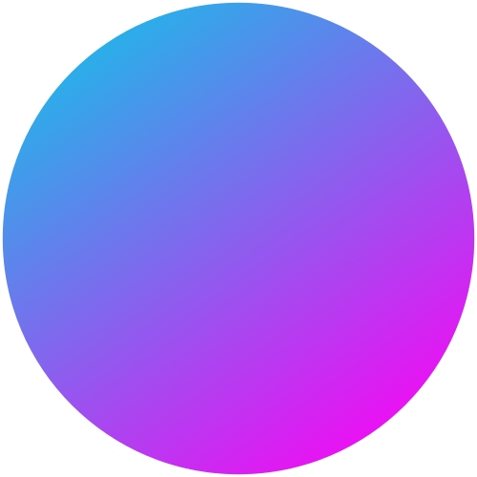
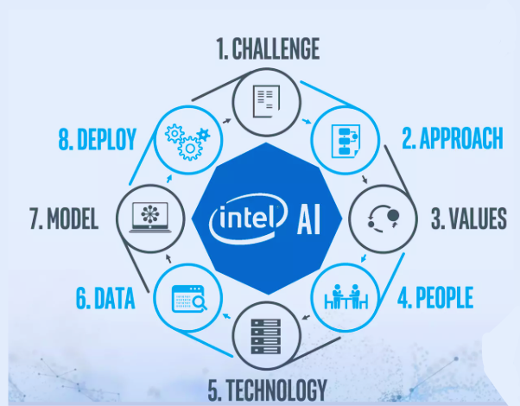
INTEL
01
Artificial intelligence for computing:
Use of AI in Intel:
The company's AI-powered Deep Neural Network Boost (DNNL) library is used to accelerate the execution of deep learning workloads. Intel is also using AI to develop new kinds of hardware accelerators, such as the Nervana Neural Network Processor (NNP).
Intel is a company that is pioneering the use of artificial intelligence (AI) in a variety of ways
02
AI for data centers:
The company is developing AI-powered algorithms that can optimize resource allocation, predict and prevent failures, and automate tasks.
03
AI for Internet of Things:
The company is developing AI-powered algorithms that can analyze sensor data, identify patterns, and make prediction

Slide 4
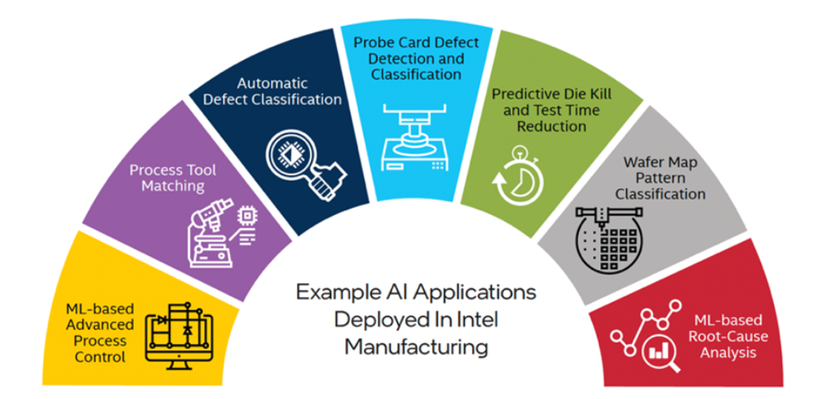
INTEL
04
AI for edge computing:
Use of AI in Intel:
Intel is also developing AI-powered tools that can help developers build and deploy edge computing applications.
Intel is a company that is pioneering the use of artificial intelligence (AI) in a variety of ways
05
AI for Healthcare:
The company is developing AI-powered algorithms that can analyze medical images, such as X-rays and CT scans, to identify abnormalities.
06
AI Developer Community:
Intel supports a community of developers interested in AI by providing resources, tools, and platforms for building and optimizing AI applications.

Slide 5


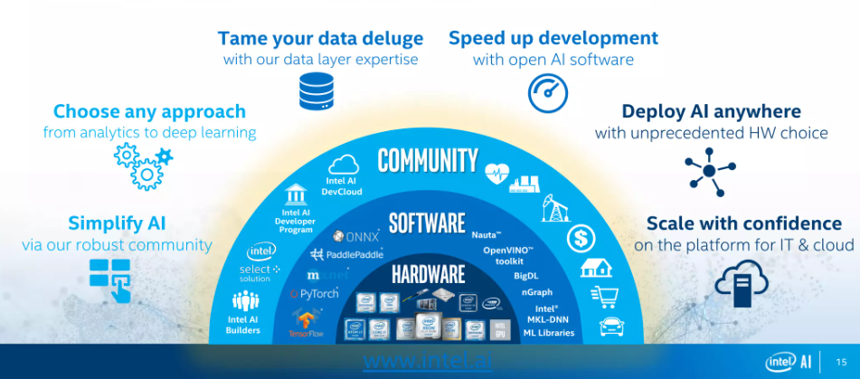
INTEL
AI In INTEL

Slide 6


INTEL
INTEL AI WORKLOADS:
Computer Vision
Intel offers a broad hardware portfolio and end-to-end AI pipeline software tools that can help you build a computer vision application with the right balance of performance and cost.
Developers and data scientists can use our open source software tools, such as the Intel® Distribution of OpenVINO™ toolkit, to develop and optimize applications that easily scale across heterogeneous devices.
Classical Machine Learning
Find connections, make predictions, and generate valuable insights by leveraging decades of investment in machine learning optimization on Intel® processors.
With a broad hardware portfolio of processors and integrated accelerators, Intel makes it easier for you find a cost-effective solution or maximize the value of your existing CPUs to meet your project .

Slide 7
INTEL AI WORKLOADS:
INTEL
Generative AI
Software tools and optimizations help to maximize performance and dramatically boost productivity both during training and deployment.
Popular data science frameworks such as PyTorch and TensorFlow, it offer optimizations that provide significant performance boosts on Intel® architecture.
Intel® oneAPI Deep Neural Network Library with highly optimized implementations of deep learning building blocks.
The oneAPI® unified programming model can also be used to support heterogeneous hardware platforms with less effort from development teams.
Recommendation Systems
IIntel offers community hubs and industry leadership to help you accelerate innovation for your AI recommender system design and development efforts. Access code and optimizations and get tips on relevant hardware solutions with key features that help ensure success for your AI deployments

Slide 8
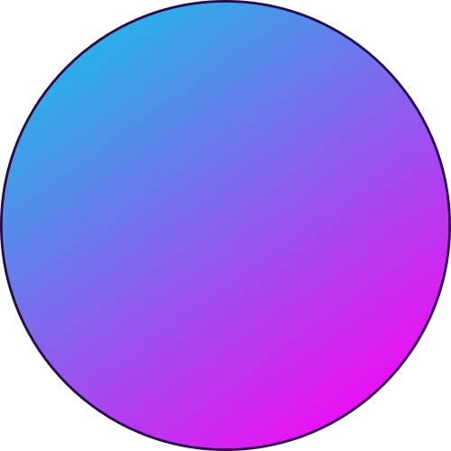
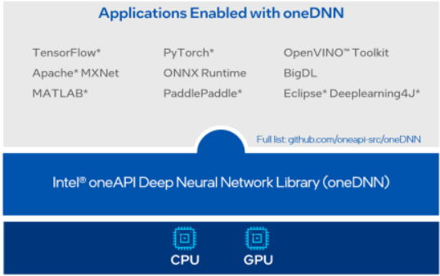
INTEL
Intel oneAPI Deep Neural Network Library
Use Cases of oneDNN:
Deep Learning training
Deep Learning Inference
Developing Deep Learning Frameworks
oneDNN is an open-source cross-platform performance library of basic building blocks for deep learning applications.
Optimized Implementations of Key Building Blocks:
Convolution
Matrix multiplication
Pooling
Batch normalization
Activation functions
Recurrent neural network (RNN) cells
Long short-term memory (LSTM) cells
Key Features of oneDNN are High Performance, Portability and open-source.

Slide 9
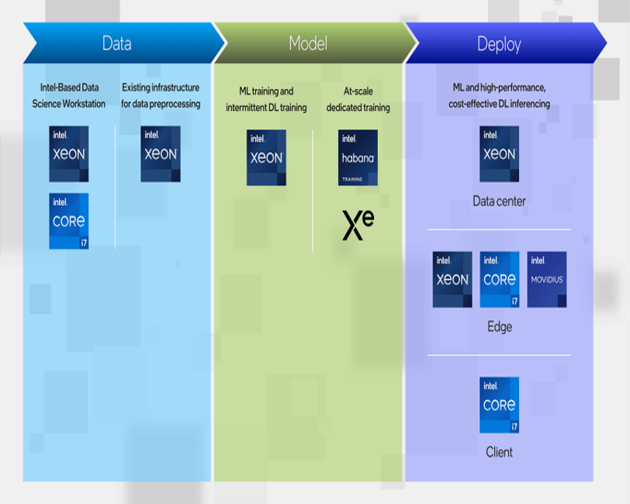
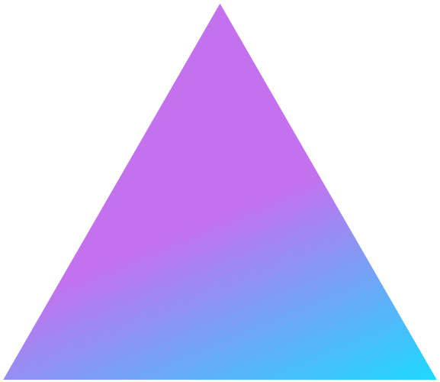
INTEL
Intel AI Hardware
The Intel portfolio for AI hardware covers everything from data science workstations to data preprocessing, machine learning/deep learning (ML/DL) modeling, and deployment in the data center and at the intelligent edge.
The goal is to offer scalability, performance, and efficiency for different applications and use cases within the AI ecosystem.

Slide 10

INTEL
Hardware AI in Intel
Intel Nervana Neural Network Processors (NNP)
Intel Movidius Vision Processing Units (VPUs)
Intel Xeon Processors
Intel acquired Nervana Systems to enhance its AI capabilities. The Nervana NNP is a family of dedicated AI processors designed for high-performance machine learning workloads
Intel's Nervana Neural Network Processor (NNP) can accelerate CNNs by up to 10 times
Movidius VPUs are designed for edge computing and are optimized for computer vision and AI inference tasks on devices with power and space constraints
Intel's Movidius Myriad X VPU can accelerate image recognition on edge devices by up to 15 times.
nItel Xeon processors are versatile CPUs used in various computing applications, including data centers. Intel has introduced optimizations in Xeon processors to handle AI workloads efficiently.

Slide 11
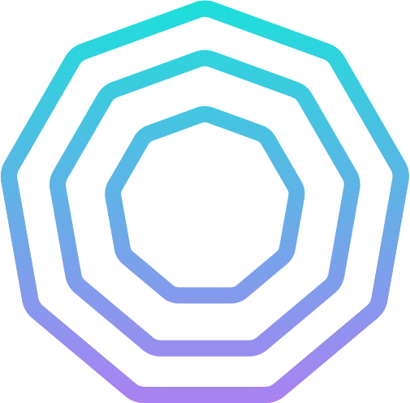
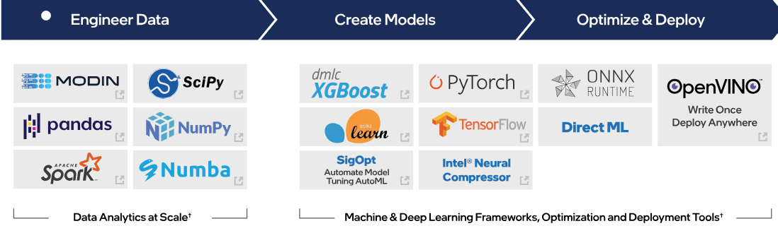
INTEL
Intel AI Software
Intel offers a comprehensive suite of software tools and frameworks for developing and deploying AI applications. These tools and frameworks are designed to work with Intel's AI hardware, including CPUs, GPUs, and accelerators, to provide optimal performance and efficiency.
o

Slide 12


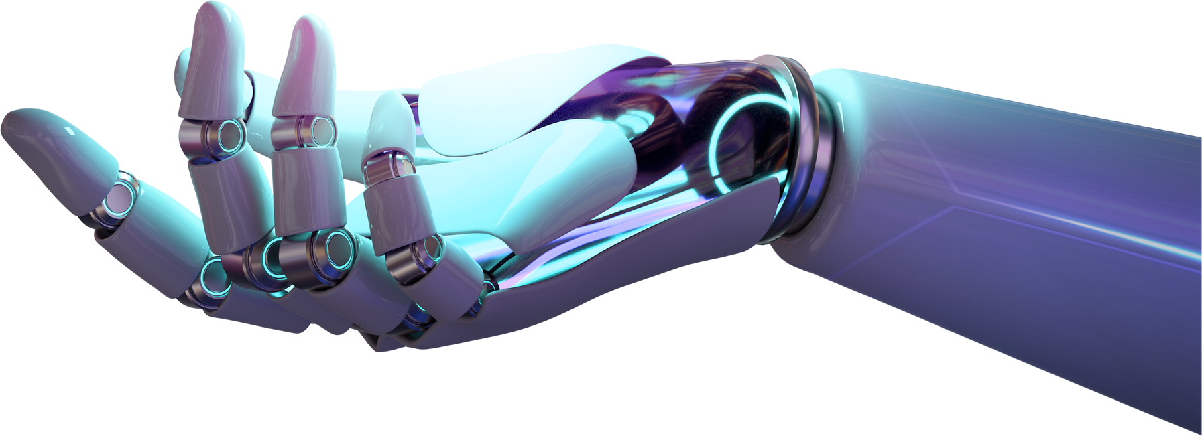
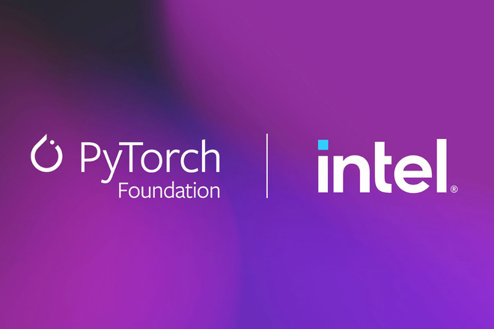
All About it
PyTorch* OPTIMIZATIONS FROM INTEL
Intel's PyTorch* Optimizations accelerate AI workloads across the entire development lifecycle, from research to production deployment.
These optimizations are designed to improve the performance, efficiency, and portability of PyTorch applications on Intel hardware.
Key benefits of Intel PyTorch Optimizations:*
Up to 10x faster training and inference performance
Simplified development with a unified programming model
Deployment flexibility across CPUs, GPUs, and FPGAs

Slide 13
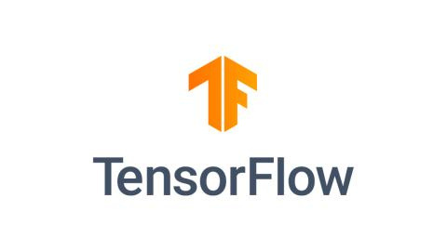
tensorflow* OPTIMIZATIONS FROM INTEL
TensorFlow* is an open source AI and machine learning platform used widely for production AI development and deployment. Often these applications require deep neural networks and extremely large datasets, which can become compute bottlenecks.
Key benefits of Intel TensorFlow Optimizations:*
Take advantage of the most up-to-date Intel software and hardware optimizations for TensorFlow.
Speed up TensorFlow-based training and inference turnaround times on Intel hardware.
Extend TensorFlow to further accelerate performance on Intel CPU and GPU hardware.

Slide 14
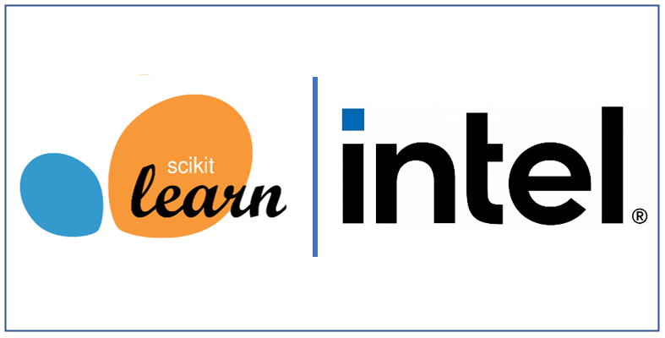
INTEL
Intel Extensions for Scikit-learn*
Scikit-learn* (often referred to as sklearn) is a Python* module for machine learning.
Intel® Extension for Scikit-learn* seamlessly speeds up your scikit-learn applications for Intel CPUs and GPUs across single-node and multi-node configurations.
Using scikit-learn with this extension, you can:
Speed up training and inference by up to 100x with the equivalent mathematical accuracy.
Continue to use the open source scikit-learn API.
Enable and disable the extension with a couple lines of code or at the command line.

Slide 15
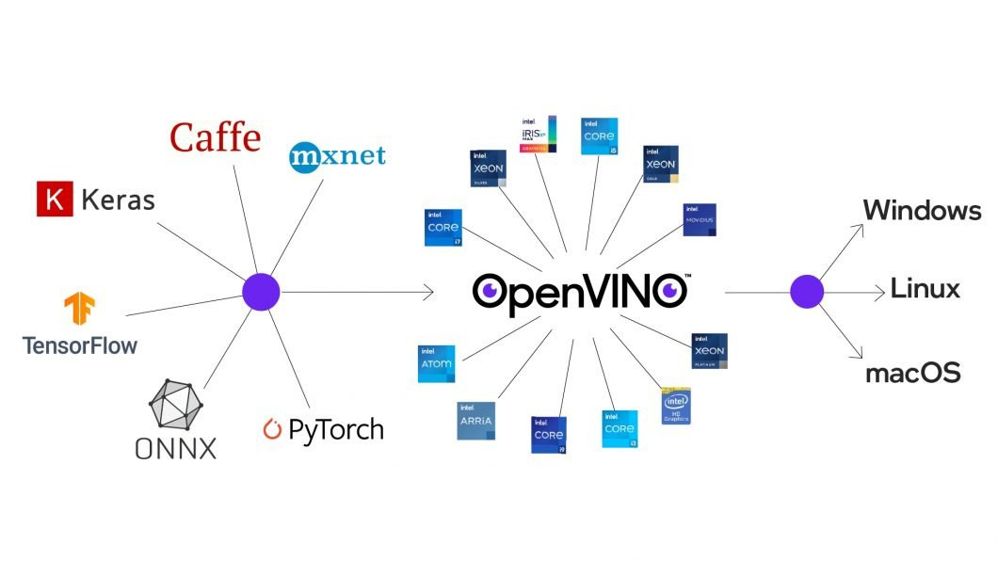
INTEL
OneAPI AI Tools
1. Unified Programming Model: oneAPI provides a unified programming model and developers can use a single codebase to target multiple Intel architectures.
2. Performance Optimizations: A suite of performance optimization tools to identify and address performance bottlenecks. These tools include performance profilers, code analyzers, and optimization recommendations.
3. Deployment Flexibility: oneAPI AI Tools enable developers to deploy their AI applications to a wide range of Intel platforms, including on-premises servers, cloud environments, and edge devices.

Slide 16

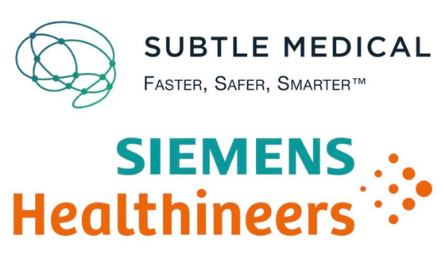

INTEL
Using 4th Gen Intel® Xeon Scalable processor with Intel® Advanced Matrix Extensions, and the Intel® Distribution of the OpenVINO™ Toolkit, allows Siemens Healthineers to speed up
the execution of AI models, lower system cost and complexity, and reduce energy consumption.
Siemens Healthineers
Boosts Medical Image Processing and Sustainability Efforts
35x speedup
20% reduction
Industry
Organization Size
intel AI inference time for auto
contouring algorithms
compared to previous gen.
in energy consumption
compared to previous gen.
Hospitals &
Healthcare
10,001+

Slide 17
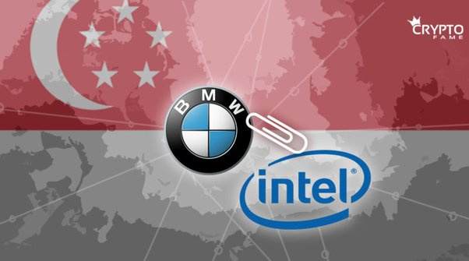
INTEL
To enable data scientists and employees to use AI
workloads for quality control on a classic desktop PC, the BMW Group uses an application developed
by Robotron with the Intel® Distribution of OpenVINO™ Toolkit.
Intel‘s toolkit accelerates and
improves machine vision with deep learning, bringing the BMW Group closer to its goal of an ”AI on
Every Employee PC”.
BMW Group
AI-based anonymization for every employee.
Industry
Organization Size
Automotive
10,001+

Slide 18
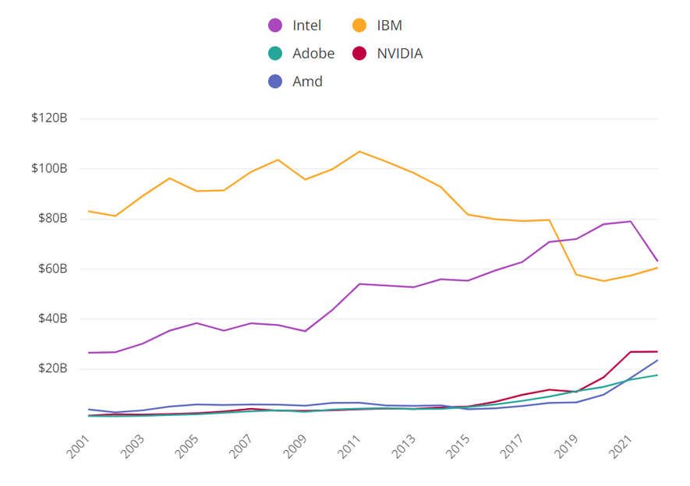
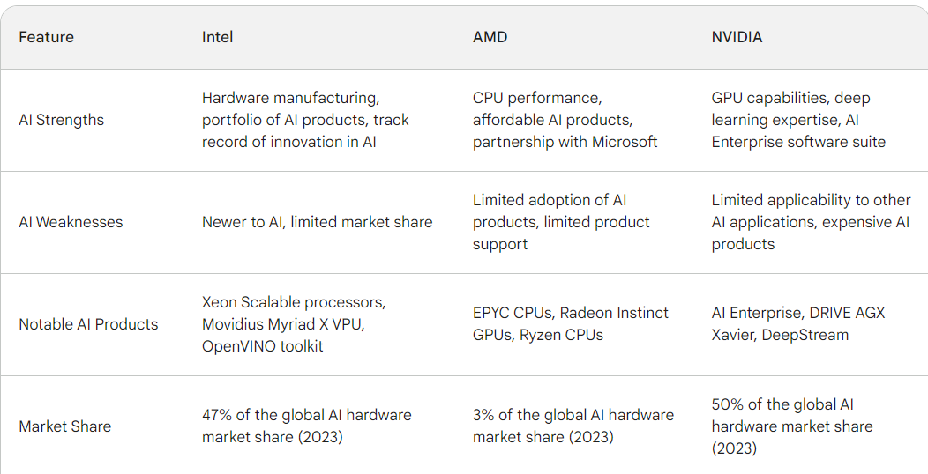
INTEL
Comparsion of Intel with other compaines:

Slide 19





INTEL
Future Scope:
Developer Ecosystem Support
Hardware Acceleration
Focus on Ethical AI
Adaptation to Market Trends
Open Source Contributions
Software Development

Slide 20

INTEL
Conclusion:
Intel is actively pursuing AI innovation and integrating AI capabilities into its products and services.
Intel's AI strategy encompasses hardware acceleration, software development, data center and edge computing solutions, AI research, and social impact initiatives.
Intel is committed to making AI accessible and beneficial for a wide range of users and applications, driving innovation and shaping the future of AI.

Slide 21
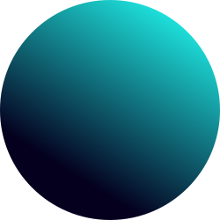
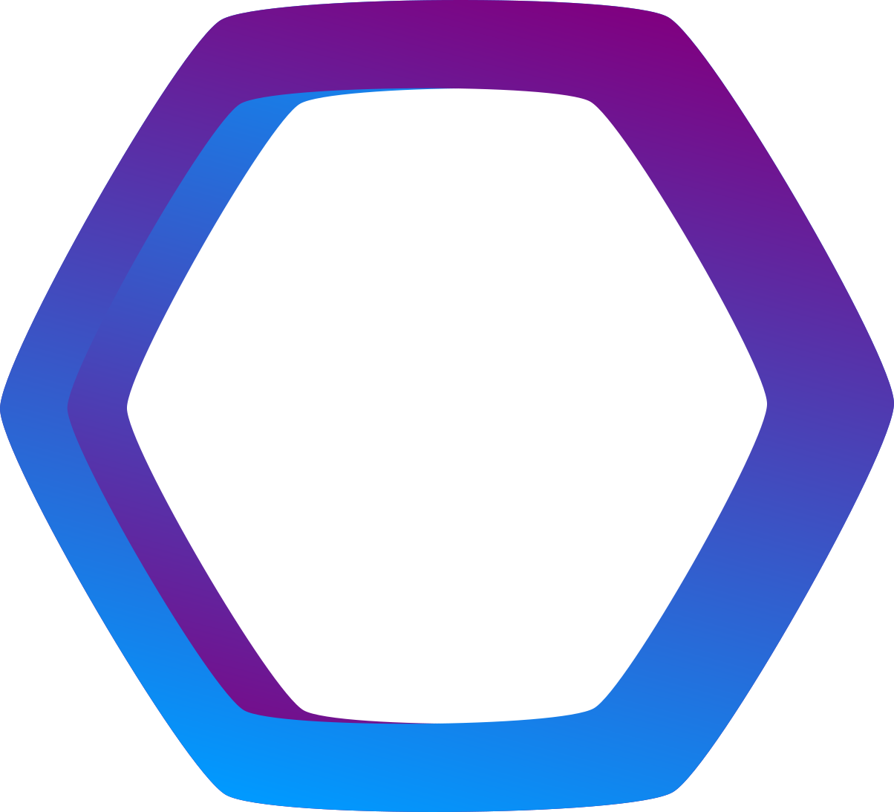

THANK YOU

